Slide 1
Online Grocery Store

Slide 2
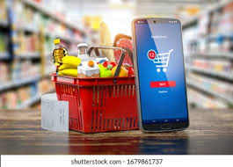
Introduction
The Online Grocery Store is a web-based platform for purchasing groceries from home.
It provides a smooth shopping experience for customers and efficient management for admins.
Developed using Python Flask, SQLite, HTML, CSS, and JavaScript.

Slide 3
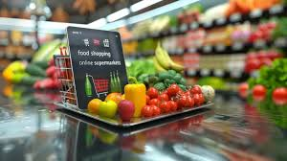
Objectives
Provide an easy-to-use online grocery shopping system.
Allow customers to browse, search, and order products.
Enable admin to manage products, orders, and users.
Offer a secure authentication and checkout process.

Slide 4
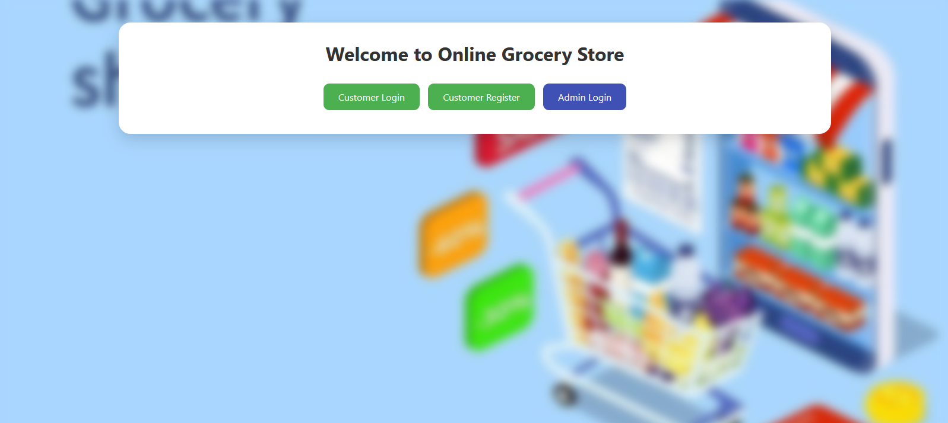
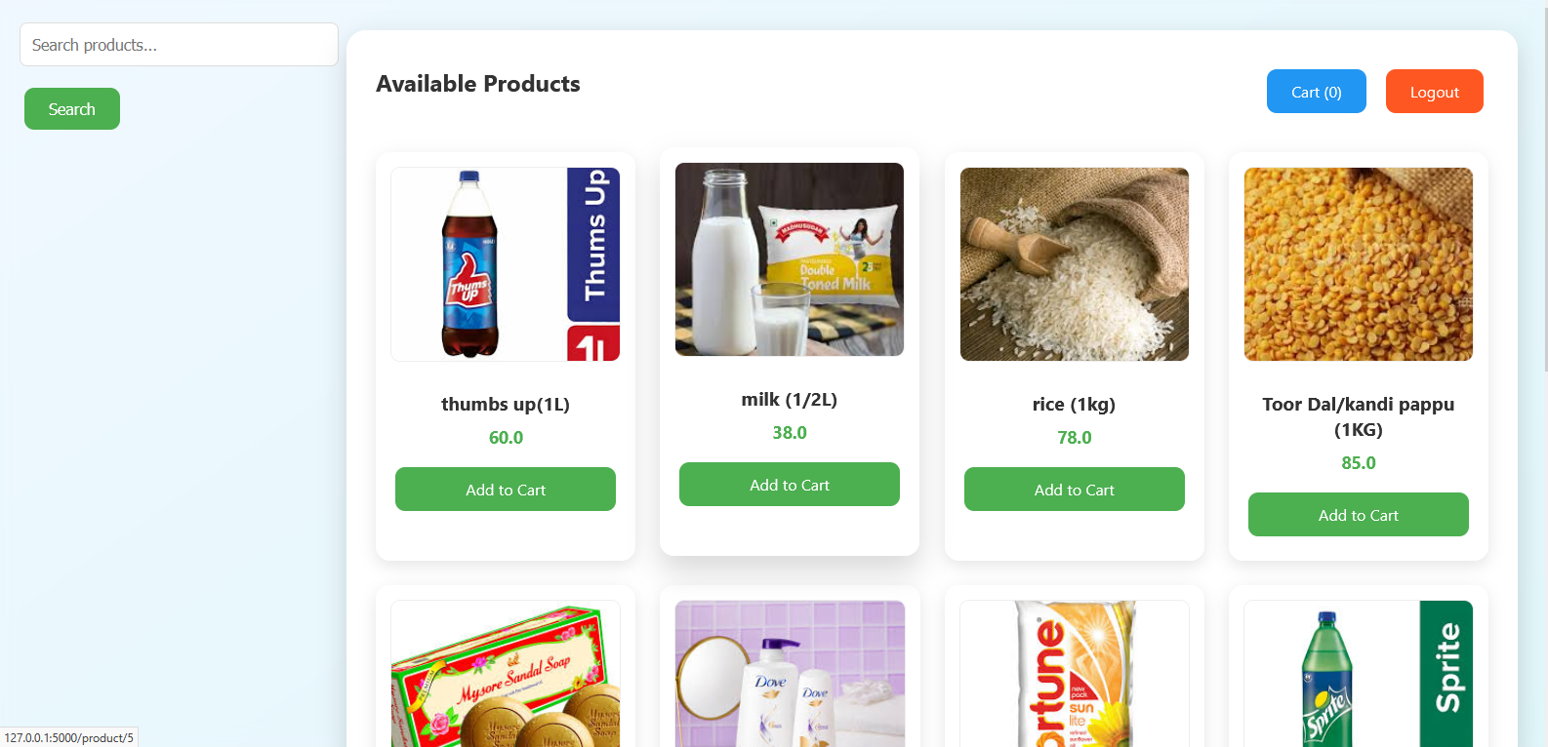
Features
Login page:
User Registration and Login
Admin Login and Dashboard
Product Search and Categories
Shopping Cart and Checkout
Order History Tracking
Responsive and Stylish UI with Animations
Customer page:

Slide 5
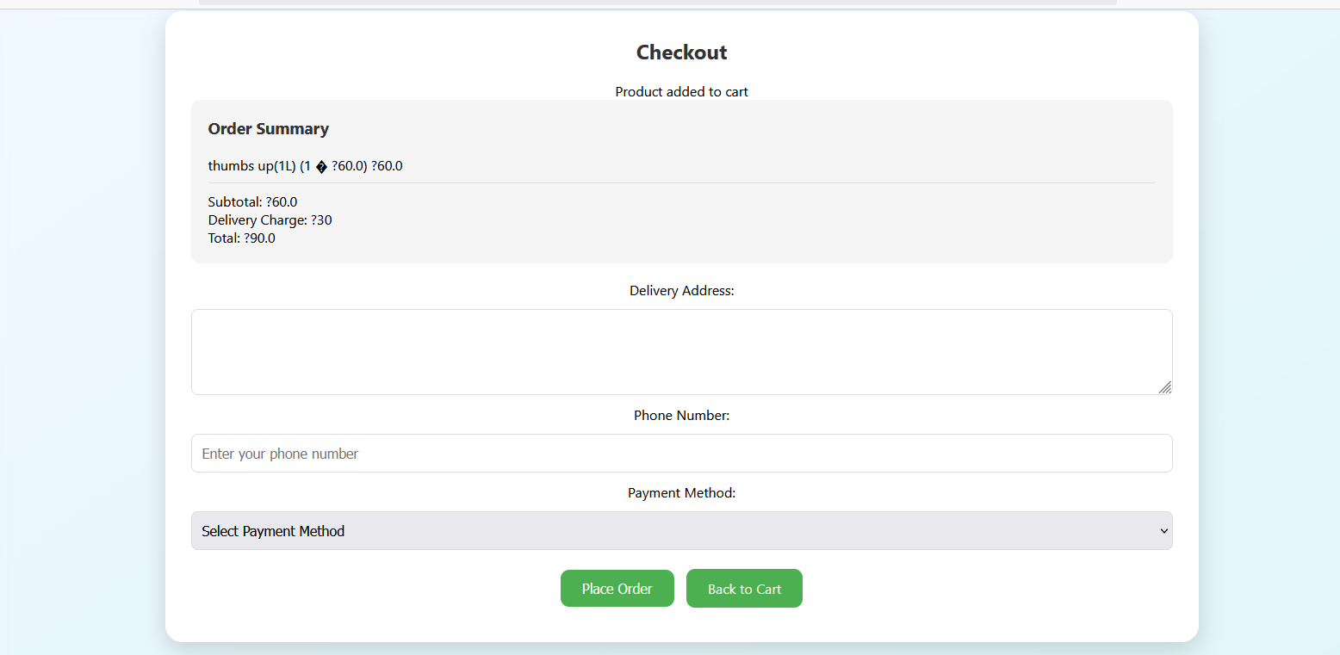
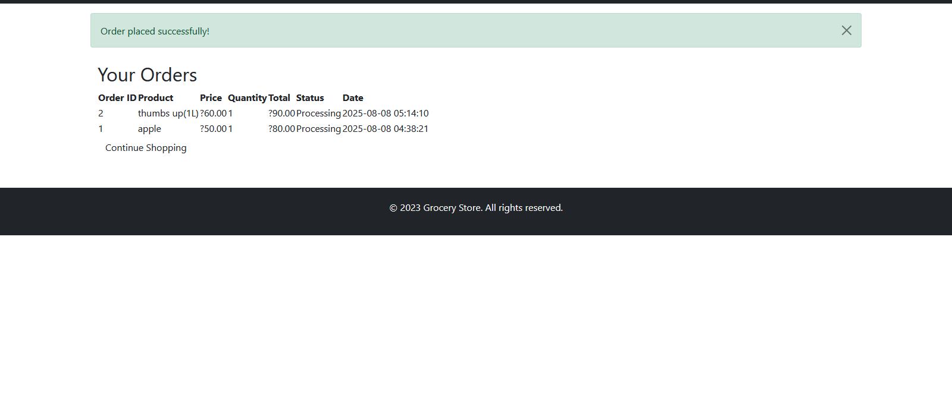
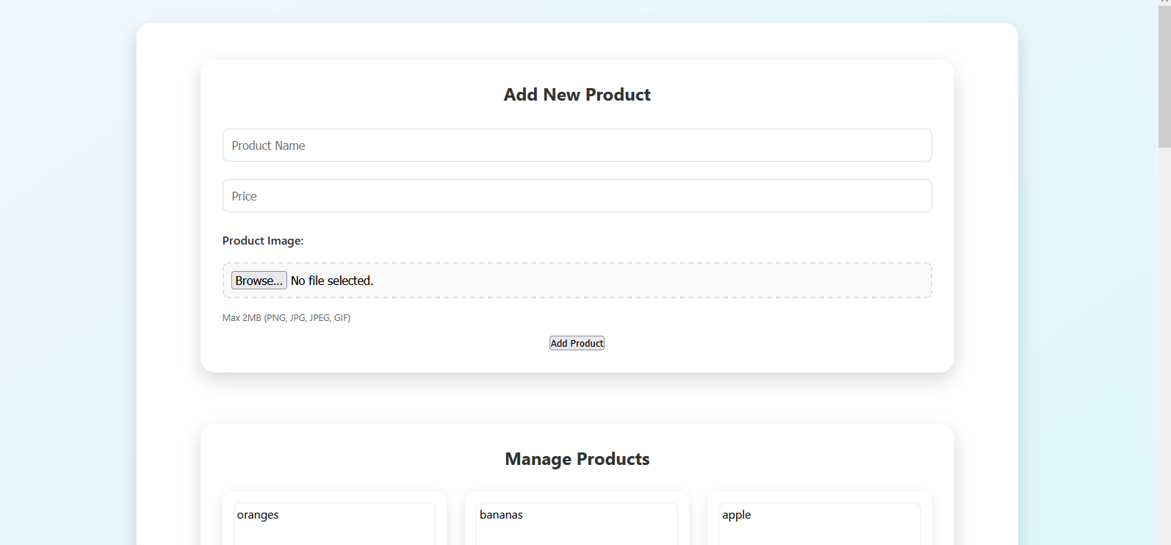
Technology Stack
Cart page:
Frontend: HTML, CSS, JavaScript
Backend: Python Flask
Database: SQLite(save data like oders’ list ect….)
Libraries: Flask-SQLAlchemy, Flask-Login, Flask-WTF
Orders list :
Admin _ dashboard:

Slide 6
Architecture
Login
login
New register
Customer login
Place the order with details
Add to cart
Admin login
Add new products
Manage the products (add,remove)
See the customer order’s list
See orders list with details

Slide 7
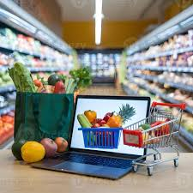
Advantages
Saves time for customers.
Provides real-time product availability.
Reduces manual workload for admin.
Scalable for more products and features.

Slide 8
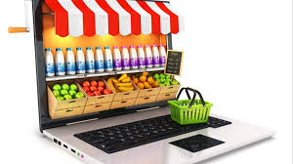
Future Scope
Add live tracking address
Implement AI-based product recommendations.
Develop mobile app version.
Add multiple admin roles and advanced analytics.

Slide 9
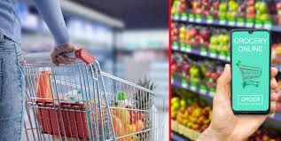
Conclusion
The Online Grocery Store project provides a complete online shopping experience.
It simplifies grocery purchasing for users and management for admins.
Can be extended with advanced features for a real-world deployment.
Thanking you

